Slide 1
DuckDB

Slide 2
DuckDB is…
It can parse GBs in 2,3 seconds on a regular laptop
Contains a wealth of methods to process data (regression, geospatial)
DuckDB is a fast, in-process analytical database.
It can run in memory, so there is no need to preserve the data on disk, reducing the need for data engineering.
In other words, we can run SQL queries on flat flies on Aurecon devices.

Slide 3
Existing workflows at Aurecon
Clean-up data sets (Collgar, clean up a data dictionary)
ETL (SKA-Low, add weather data to survey)
Geospatial analyses (today)
Reports on flat data (Personal Finance)
Ad-hoc queries on large data sets (Transmission)
Migrating cloud workflow back on our laptops (Dion)

Slide 4
Jerome Lefebvre
Manager @ Aurecon within Asset Management Performance
This talk is inspired by work at Aurecon but not done as part of Aurecon
Last 10 years
Helping companies gain operational efficiencies using real-time data
Python credentials:
Aspirational (rocking somepythonguy@gmail.com since 2005)
https://github.com/JeromeLefebvre/DuckDB-Era5-Transmission
Today:
Measuring the impact of weather on the electricity grid (using DuckDB and Python)

Slide 5
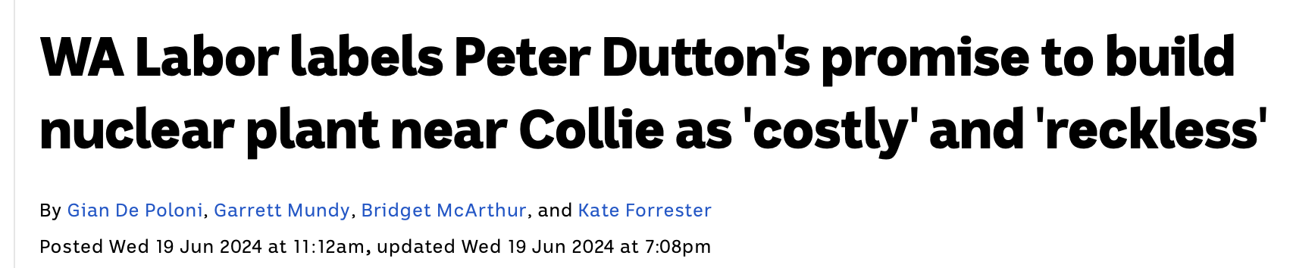
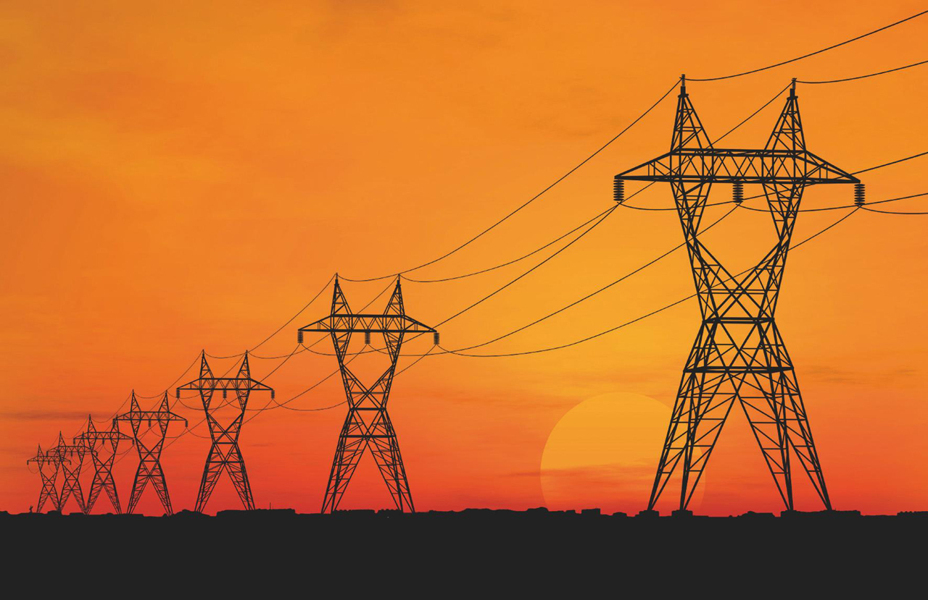
The WA energy future and the grid
WA Energy transmission:
Solar
Wind
Batteries
Lots of hope
Transmission lines are hard:
There is a backlog
Costly
Our favourite pastime is NIMBYsm

Slide 6
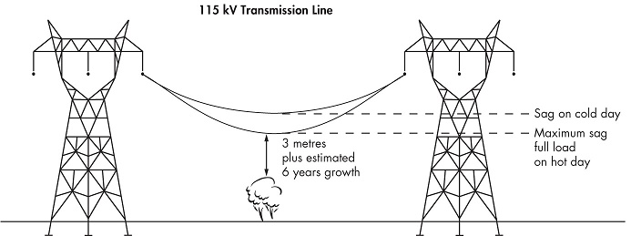
Weather's impact on transmission lines: SAG
Risk:
Fires
Trips
Safety
There is also a loss of operational efficiency as sag leads to less capacity of the grid

Slide 7
Thermal Capacity
Maximal Thermal Capacity
Net Current Carrying Capacity

Slide 8
Thermal Capacity
Heat Gain:
High ambient temp
Solar irradiance
Maximal Thermal Capacity
Net Current Carrying Capacity

Slide 9
Thermal Capacity
Heat Gain:
High ambient temp
Solar irradiance
Maximal Thermal Capacity
Net Current Carrying Capacity
Heat Loss:
Low ambient temp
Wind

Slide 10
Thermal Capacity
Heat Gain:
High ambient temp
Solar irradiance
Maximal Thermal Capacity
Net Current Carrying Capacity
Heat Loss:
Low ambient temp
Wind
Static Rating
Potential Capacity

Slide 11
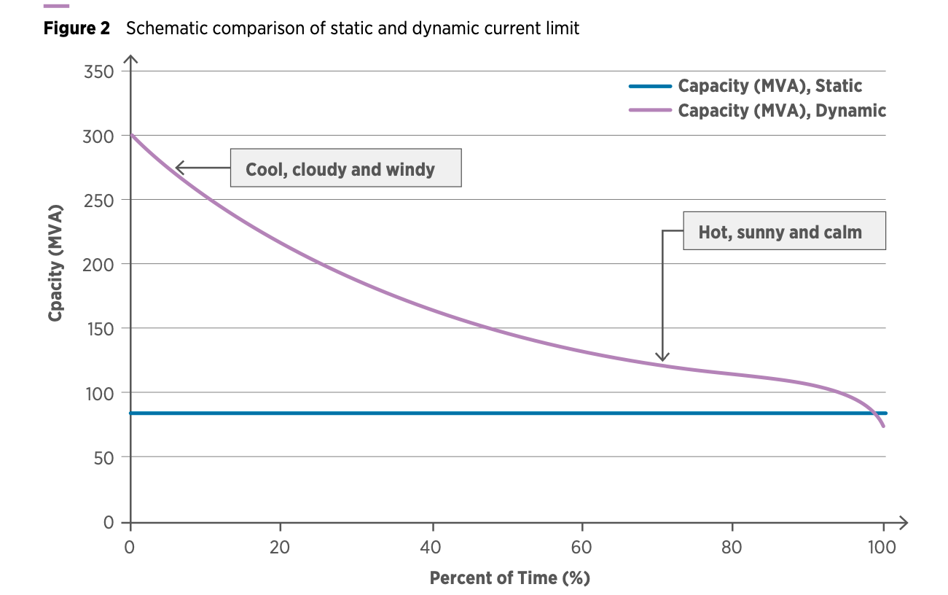
Static Capacity

Slide 12

Approach: Attach sensors all over the place

Slide 13
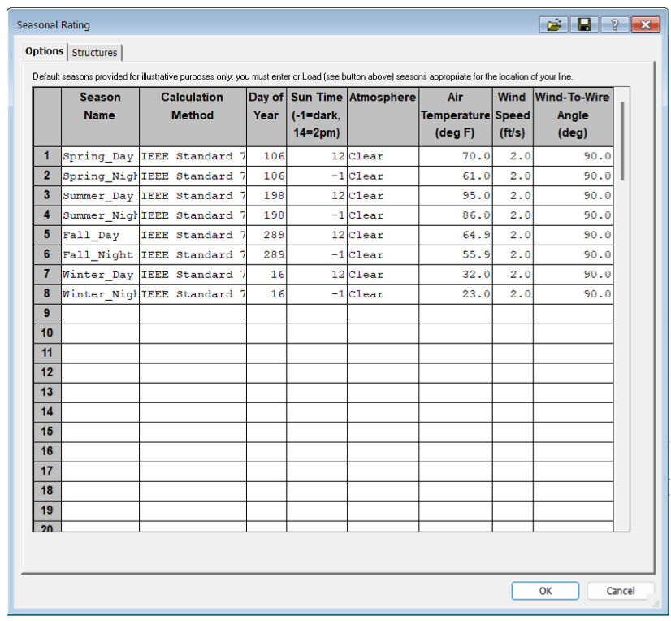
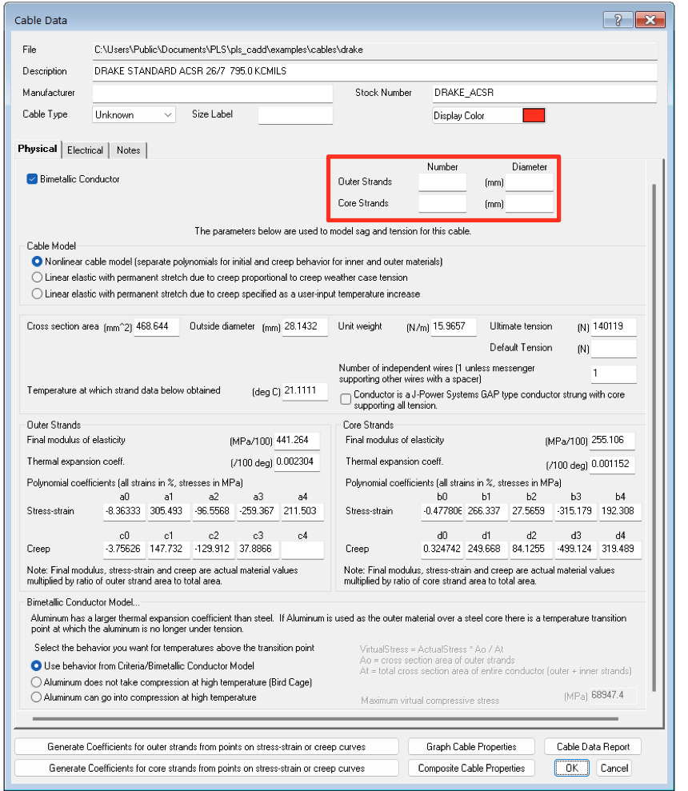
Out of the box software
Notes:
https://www.powline.com/technotes/ThermalRating.pdf

Slide 14

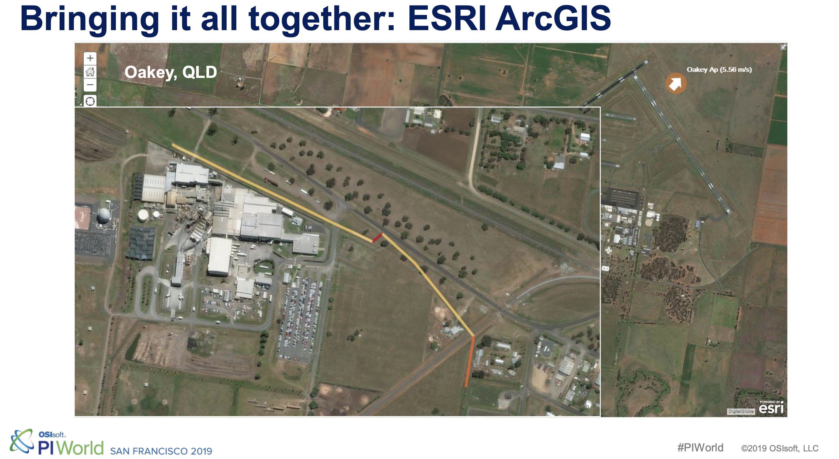
Approach: Simulate the weather loss

Slide 15








$$$
A fair fight!

Slide 16
Needs Three ingredients
Calculating the impact of weather on transmission lines
Transmissions lines
Weather Data

Slide 17
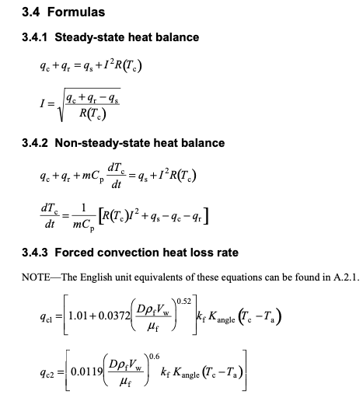

Calculations

Slide 18
Notes:
https://www.powline.com/technotes/ThermalRating.pdf

Slide 19
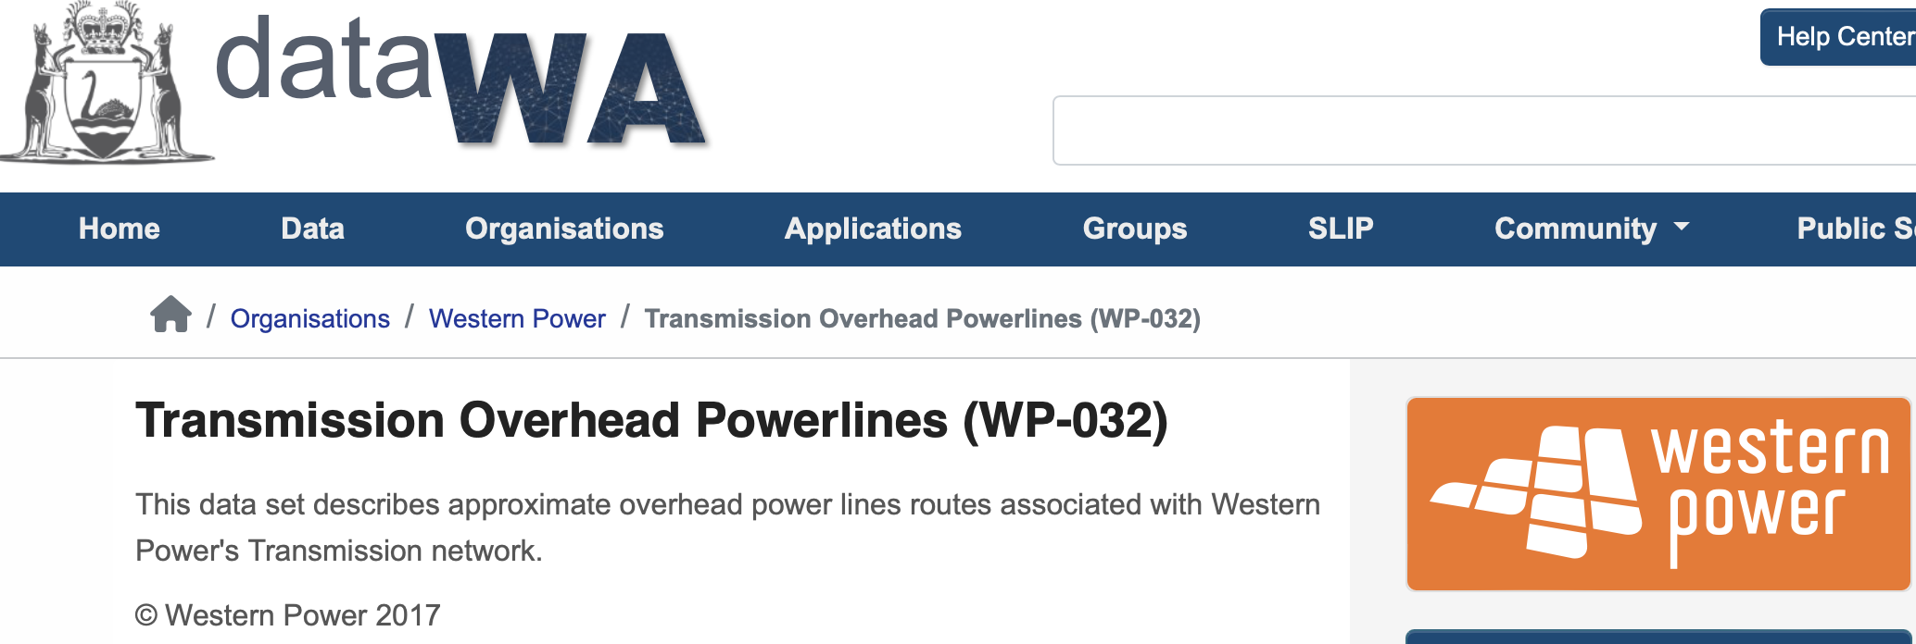
The transmission data
Geospatial data
Capacity
Name

Slide 20
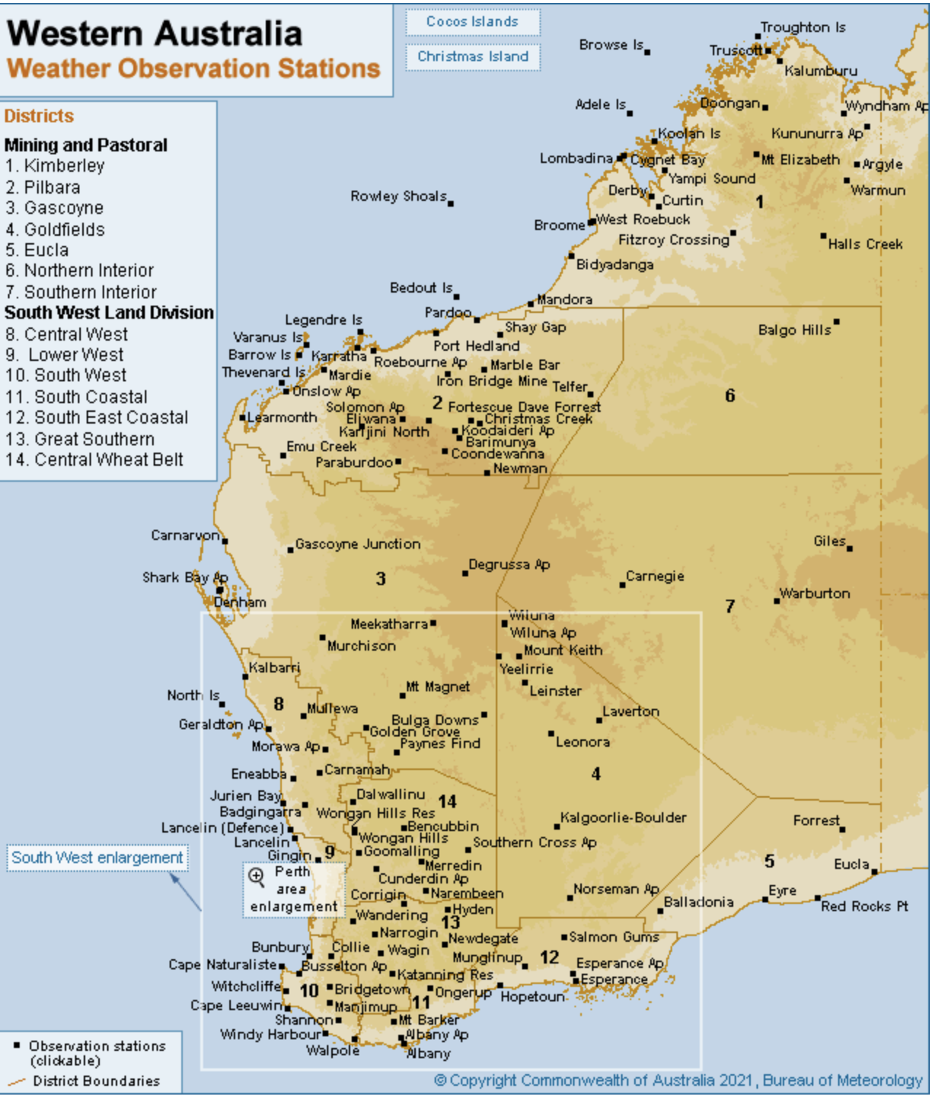
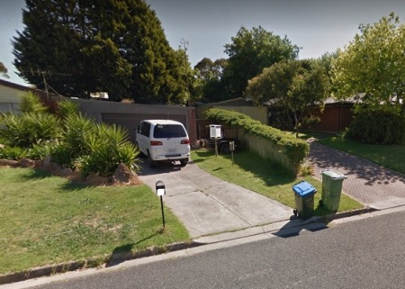
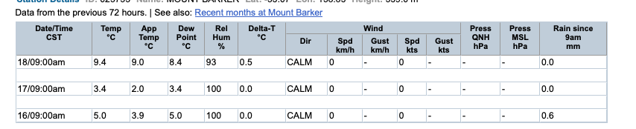
What is BOM Data

Slide 21
What is BOM Data

Slide 22
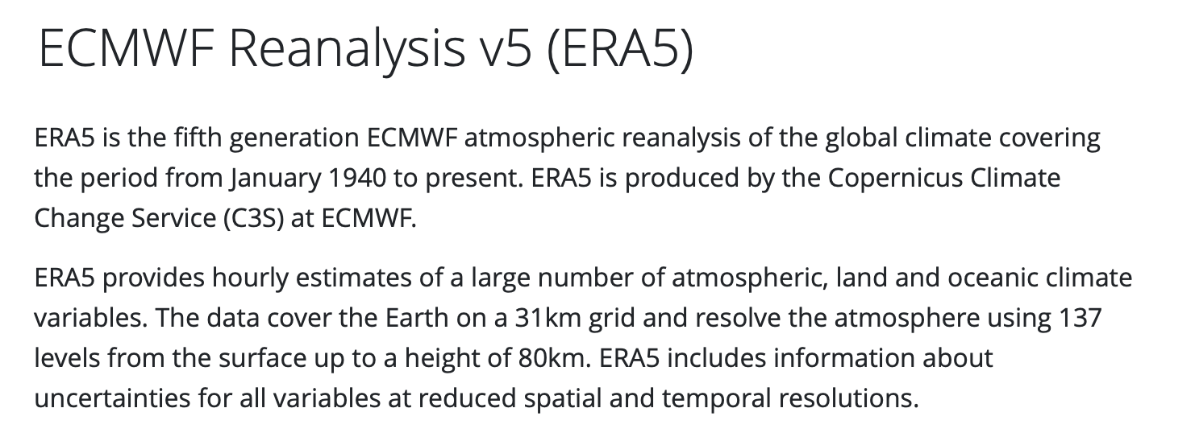
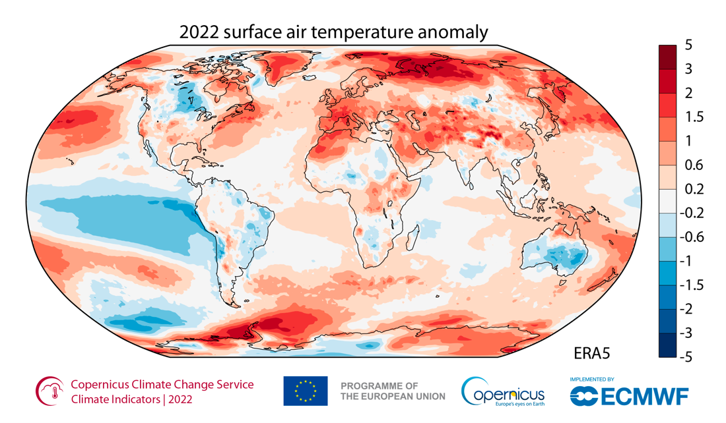
Let’s use simulated weather data
Add image

Slide 23




Today’s Data Flow
Inputs
Query#1
Calculate averages
Query#3
Join the inputs
Query#4
Apply model
Query #5, #6, #7
What about this?
What about that?
Era5 or BOM Weather
.csv, .parquet, .json
Query#2 Decompose into spans
DuckDB
Scripting
Power BI/Excel,
QGIS, Grafana, qStudio
Merge
Enrich
Visualise
Western Power Transmission.shp

Slide 24
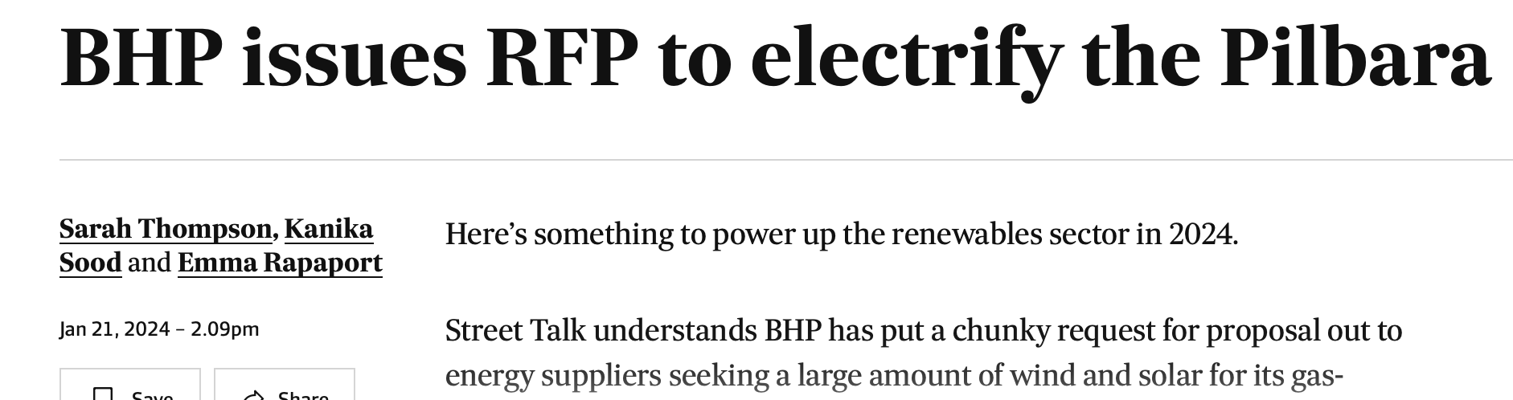
Where will new lines be built?

Slide 25

Weather average
Year: 200*, month: January
8am
8am
Average weather at 8am
On a January
8am
8am
8am

Slide 26
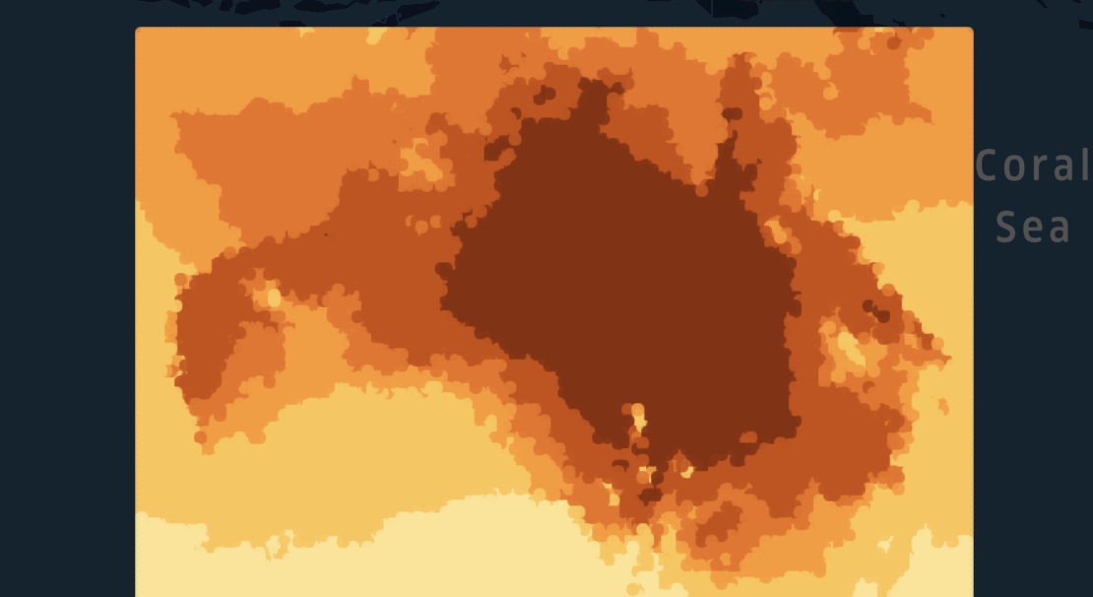
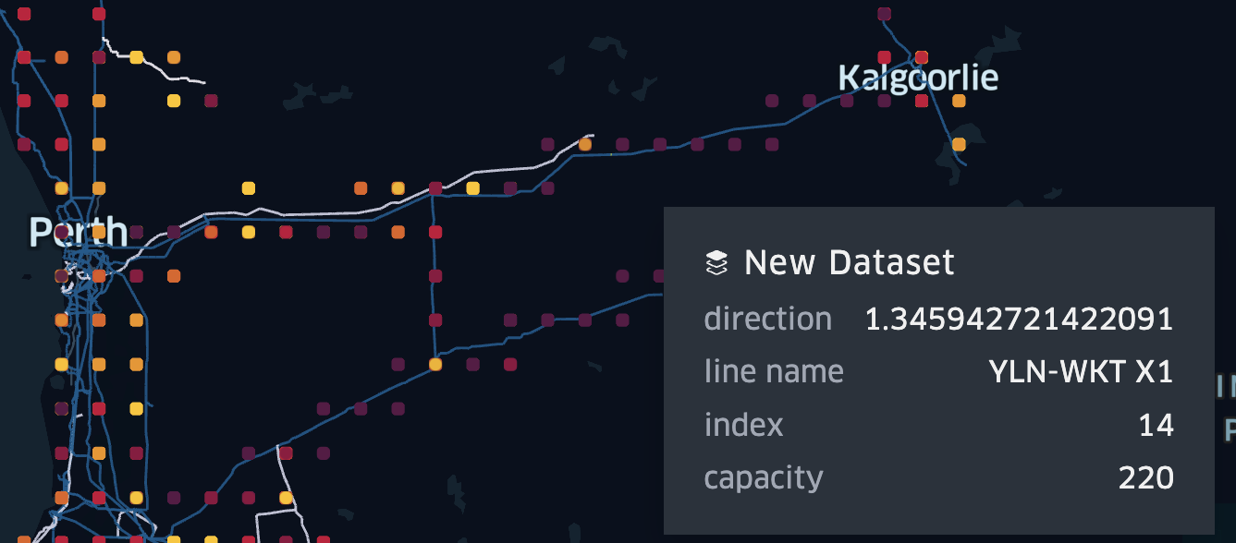
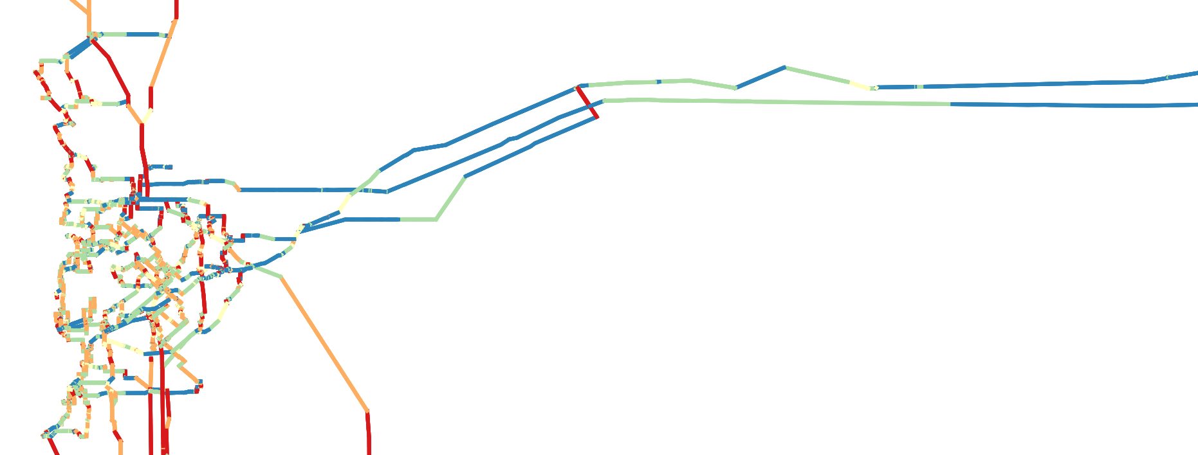
Queries
# 2 Apply some averages the to weather
#1 Split the Western Power Grid into segment, add foreign keys
#4 Add in IEEE738 Calculations (python)
#3 Joining the data set
#5, #6, #7, …
Average 8 am in June-July power efficiency gain?
Should we ask this battery to only discharge at 5 pm?
Part of the grid most impacted by the extreme weather?

Slide 27
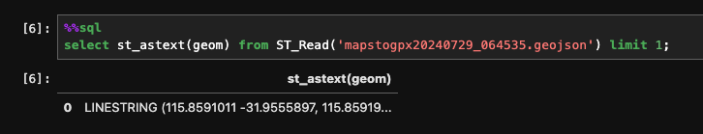
From python
If using Jupyter install jupysql

Slide 28
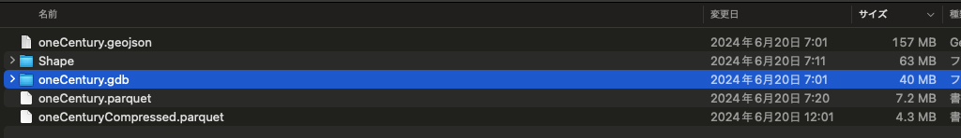
Compare sizes

